Slide 1
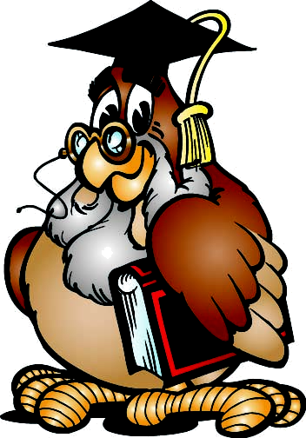
QUIZ

Slide 2
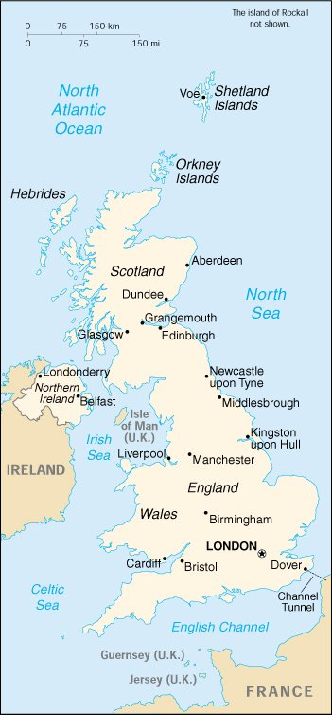
The UK
What is the official name of the UK?

Slide 3
Riddles
There are six of us in every family, but only four in a town. What are we?

Slide 4
Geography
How many countries are there in the UK?

Slide 5
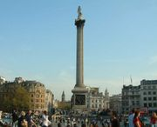
London
What can you see in the middle of Trafalgar Square?

Slide 6
The UK
What are the capitals of all the countries of the UK?

Slide 7
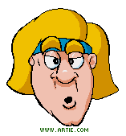
Riddles
Which month has 28 days?

Slide 8
History
Which group of people invaded Britain in 1066?

Slide 9
Holidays around the world
What season is in Australia when they celebrate Christmas?

Slide 10
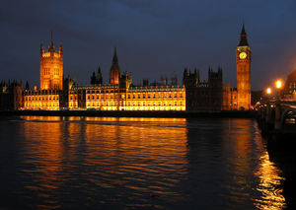
London
When was the great fire of London?

Slide 11
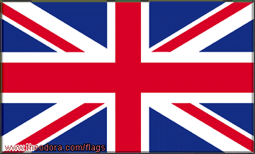
The UK
The flag of the UK is known as ….

Slide 12
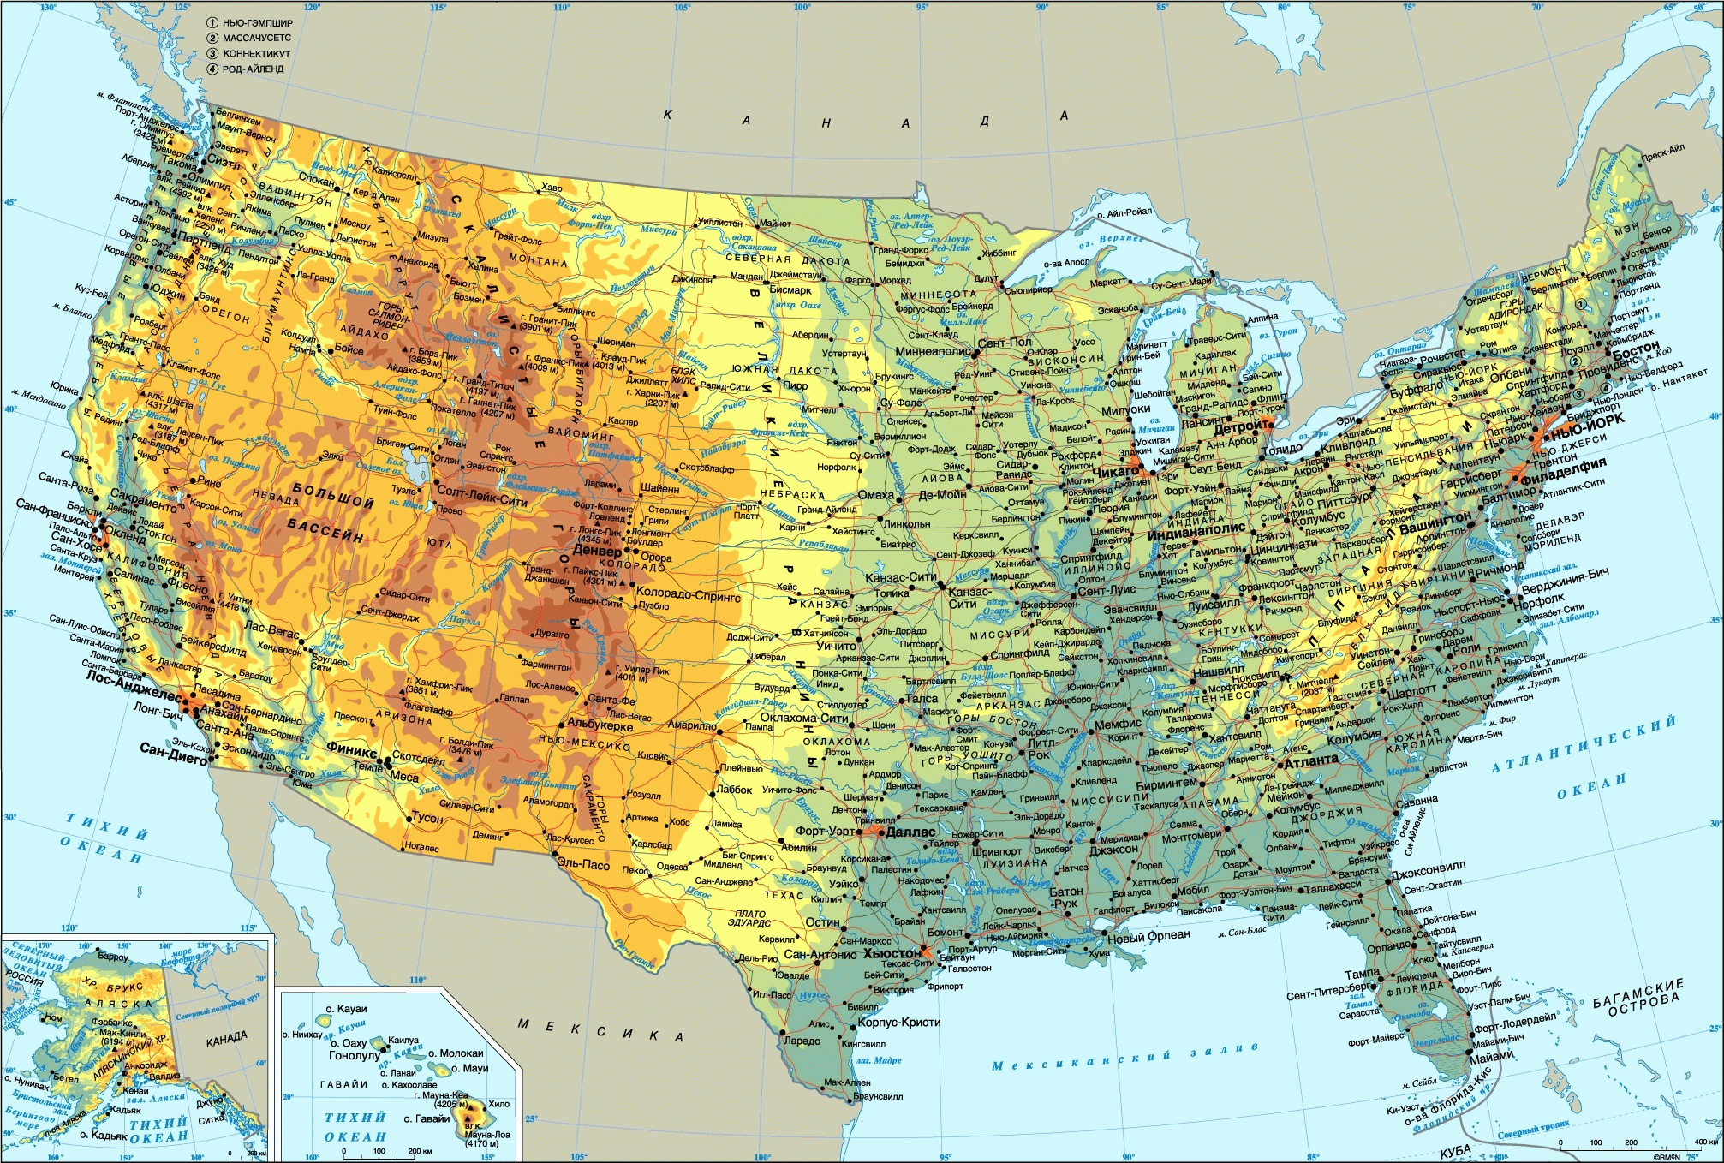
Riddles
I have cities but no houses; forests but no trees, rivers but without water. What am I?

Slide 13
History
The monarch of United Kingdom is not the monarch of which country?
South Africa
Canada
Australia
New Zealand

Slide 14
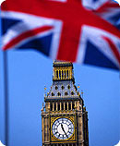
Holidays around the world , 300
What holiday do English people celebrate on the 5th of November?

Slide 15
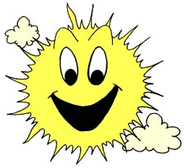
London
Where are the tombs of many kings and queens and other famous people?

Slide 16
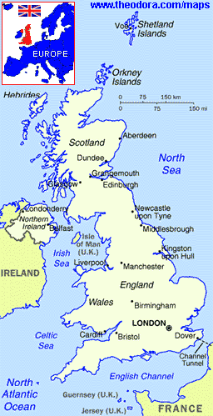
The UK
What is Great Britain? What does it include?

Slide 17
Riddles
What has no head, no arms, no legs, and still has a tongue?

Slide 18
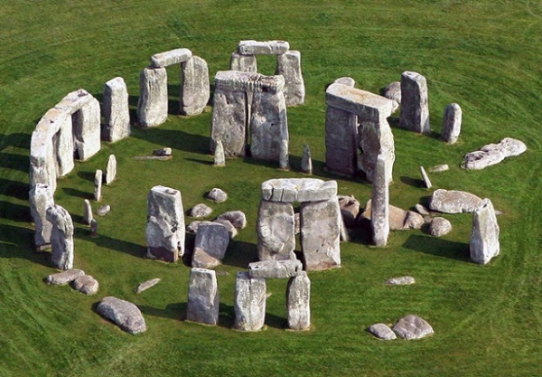
History
Which ancient monument would you find on Salisbury Plain?

Slide 19
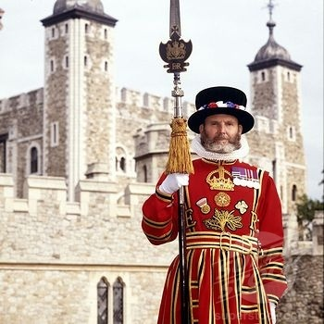
London
Who is a beefeater?

Slide 20
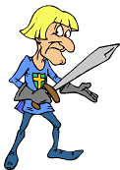
The UK
Who is the head of England?

Slide 21
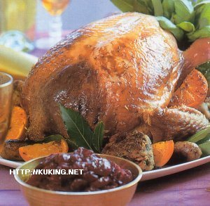
Holidays around the world
What holiday is celebrated in the USA on the fourth Thursday in November?

Slide 22
Geography
Which country accounts for just over half of the total square miles of theUnited Kingdom?

Slide 23
Thank you for your participation!

Slide 24
The UK
What is the official name of the UK?
The United Kingdom of Great Britain and Northern Ireland

Slide 25
Riddles
There are six of us in every family, but only four in a town. What are we?
Letters

Slide 26
Geography
How many countries are there in the UK?
4

Slide 27
London
What can you see in the middle of Trafalgar Square?
The statue of Admiral Nelson

Slide 28
The UK
What are the capitals of all the countries of the UK?
Belfast, Cardiff, London, Edinburgh

Slide 29
Riddles
Which month has 28 days?
They all have 28 days

Slide 30
History
Which group of people invaded Britain in 1066?
Normans

Slide 31
Holidays around the world
What season is in Australia when they celebrate Christmas?
summer

Slide 32
London
When was the great fire of London?
in 1666

Slide 33
The UK
The flag of the UK is known as ….
the Union Jack

Slide 34
Riddles
I have cities but no houses; forests but no trees, rivers but without water. What am I?
a map

Slide 35
History
The monarch of United Kingdom is not the monarch of which country?
South Africa
Canada
Australia
New Zealand
South Africa

Slide 36
Holidays around the world , 300
What holiday do English people celebrate on the 5th of November?
Guy Fawkes Night

Slide 37
London
Where are the tombs of many kings and queens and other famous people?
in Westminster Abbey

Slide 38
The UK
What is Great Britain? What does it include?
an island
England, Wales, Scotland

Slide 39
Riddles
What has no head, no arms, no legs, and still has a tongue?
a shoe

Slide 40
History
Which ancient monument would you find on Salisbury Plain?
Stonehenge

Slide 41
London
Who is a beefeater?
a person who guards the Tower of London

Slide 42
The UK
Who is the head of England?
A queen or a king

Slide 43
Holidays around the world
What holiday is celebrated in the USA on the fourth Thursday in November?
Thanksgiving day

Slide 44
Geography
Which country accounts for just over half of the total square miles of the United Kingdom?
England

